Slide 1
Color Transfer Between Images
Mini Project: Team "nqb"
Bora Buyukturk, Hakki Can Karaimer, Nguyen Q. Binh

Slide 2
What We Solved
We solved color transfer between images using two different algorithms.
To apply different transformations to different parts of image, we used three different approach.

Slide 3
The Goal
Alter an image’s color
Example: removing a dominant and undesirable yellow in a photo taken under incandescent illumination
Borrow one image’s color characteristics and look and feel from another
Modify all color channels in tandem and changing pixels’ color in a coherent way
Color Transfer between Images (2001)
Statistics and color correction
Choosing a suitable color space to human vision and natural scenes
Minimum correlation between channels
lαβ orthogonal perception-based color space of Ruderman et al
Independent operations in color channels

Slide 4
# scale by the standard deviations l = (lStdSrc / lStdTar) * l a = (aStdSrc / aStdTar) * a b = (bStdSrc / bStdTar) * b
Initial code: http://www.pyimagesearch.com/2014/06/30/super-fast-color-transfer-images/

Slide 5
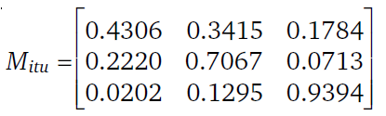
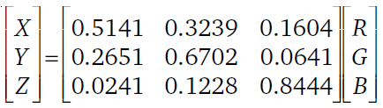
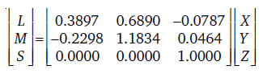
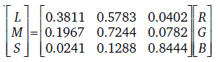
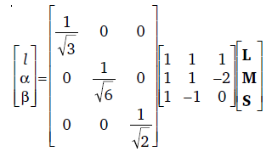
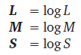
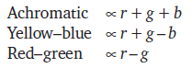
LEVEL-1: Color transfer by matching variances
Decorrelation Operations
RGB -> XYZ device-independent tristimulus values
XYZitu601-1 (D65) standard conversion matrix
M_{itu}x = (111)^{T} -> solve for x
XYZ ->LMS cone space normalization
Logarithmic space to eliminate skewness on the data
LMS -> lαβ maximal decorrelation using PCA
Variant of opponent-color models
An achromatic channel (I), chromatic yellow–blue (α) and red–green (β) opponent channels
Achromatic axis is orthogonal to the equiluminant plane
Notes:
The International Telecommunications Union

Slide 6
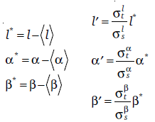
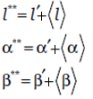
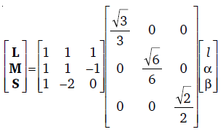
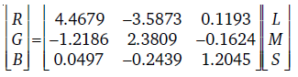
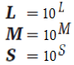
LEVEL-1: Color transfer by matching variances
Color processing, color transfer Operations [1]
along each of the three axes:
Subtract µ source from the source data points
l* = ls - µls, α* = αs - µαs , β* = βs - µβs
scale the data points by respective standard deviations σt/σs
l’ = l*.σt/σs , α’ = α*.σt/σs , β’ = β*.σt/σs
Add µ target
L**= l’ + µlt , α**= α’ + µαt , β**= β’ + µβt
Convert back to RGB
lαβ -> log⁻¹ LMS (10^{x}) -> LMS -> XYZ -> RGB

Slide 7
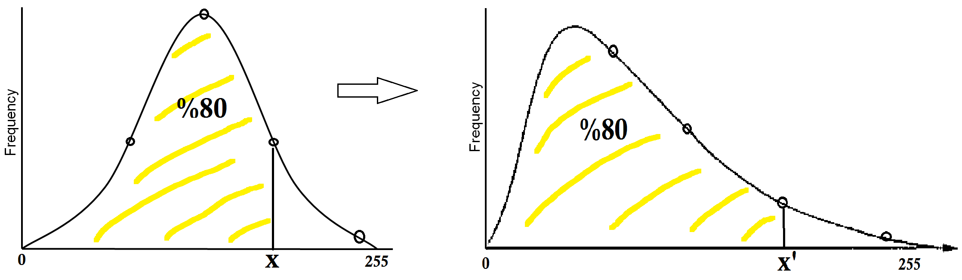
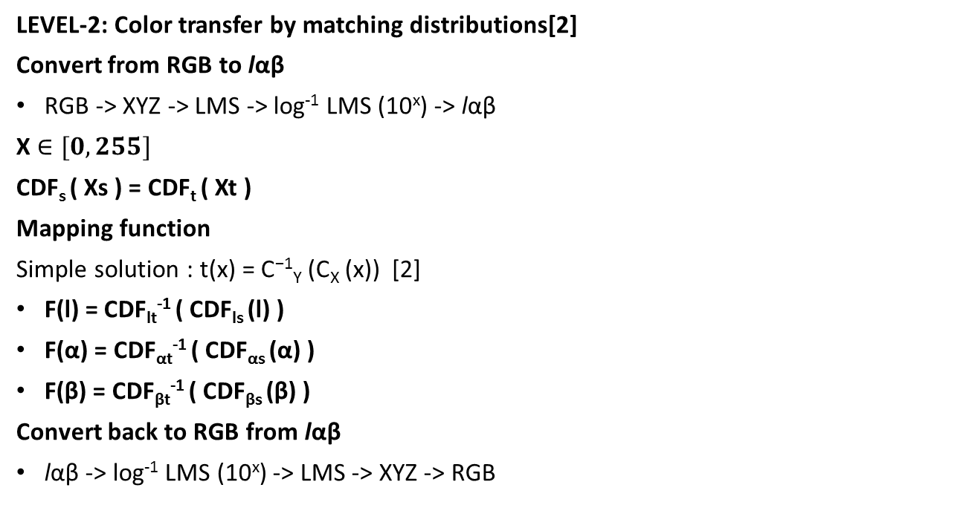
LEVEL-2: Color transfer by matching distributions[2]
Convert from RGB to lαβ
RGB -> XYZ -> LMS -> log⁻¹ LMS (10^{x}) -> lαβ
X $∈[0,255]$
CDF_{s} ( Xs ) = CDF_{t} ( Xt )
Mapping function
Simple solution : t(x) = C⁻¹_{Y} (C_{X} (x)) [2]
F(l) = CDF_{lt}⁻¹ ( CDF_{ls} (l) )
F(α) = CDF_{αt}⁻¹ ( CDF_{αs} (α) )
F(β) = CDF_{βt}⁻¹ ( CDF_{βs} (β) )
Convert back to RGB from lαβ
lαβ -> log⁻¹ LMS (10^{x}) -> LMS -> XYZ -> RGB

Slide 8
LEVEL-2: Implementation details
-
Swapping values simple technique
D1= [… 230,…,22,..113,…22,…55, … 167, …, 12,…25,…]
D2= [… 33,…,173,…212,…111,… 17, …, 212,…,172,…34]
Sorted D1= […12,…,22,22,22,…,25,..,55,…,113,…,167,…,243]
Sorted D2= […,17,..,33,…,34,..,111,…,172,173,…,212, 212,…]
. . . .
Cautions!
- What if # of pixels are not equal?
* We populated missing values at equidistance points
- During swapping, what if two different values get the same value! Theoretically not proper!
* Histogram matching with high discretization resolution. It spreads values better instead of populating.
Swapping values simple technique
D1= [… 230,…,22,..113,…22,…55, … 167, …, 12,…25,…]
D2= [… 33,…,173,…212,…111,… 17, …, 212,…,172,…34]
Sorted D1= […12,…,22,22,22,…,25,..,55,…,113,…,167,…,243]
Value 22: 52th in 700pixels -> 100000*(52/700)= 74285th in 100000 pixels, AUC ~ 0.074285
Value 22: 53th in 700pixels -> 100000*(53/700)= 75714th in 100000 pixels, AUC ~ 0.075714
Value 22: 54th in 700pixels -> 100000*(54/700)= 77142th in 100000 pixels, AUC ~ 0.077142
Lookup 74285th element or closest one to it in sorted D2 dictionary.
It may correspond to 74444th key in D2 dictionary as 67th of 900.

Slide 9
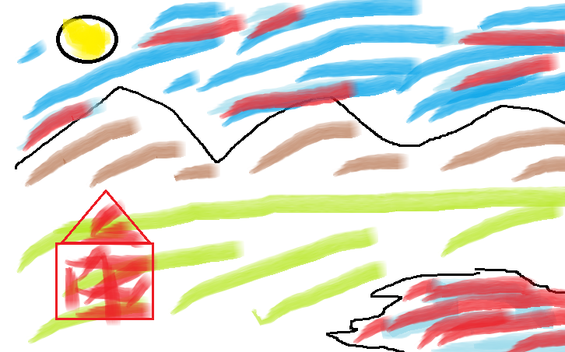
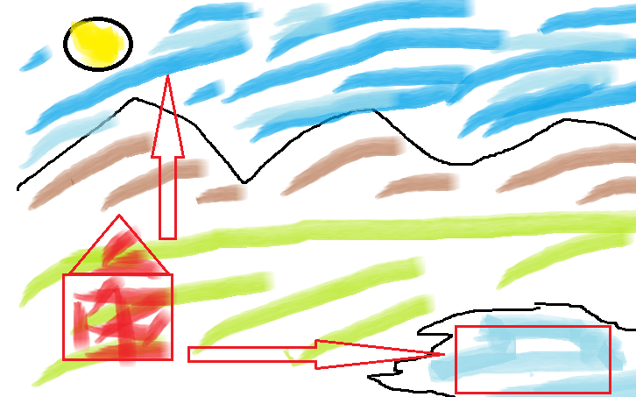
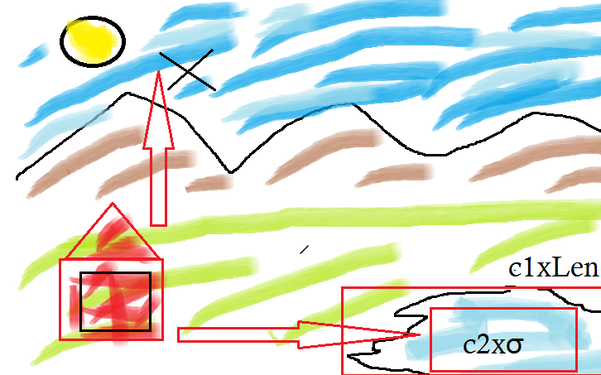
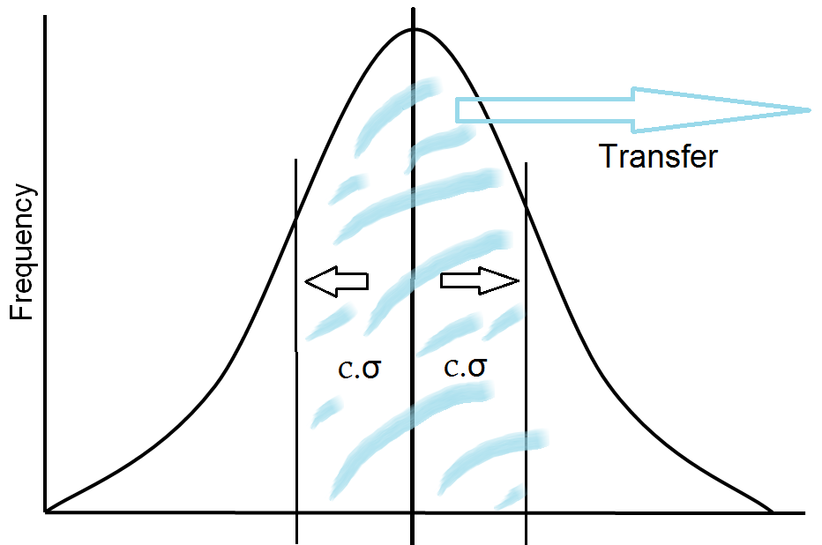
LEVEL-3:
Apply techniques of level 1 and 2
Selected a boundary to calculate statistics µ & σ
Boundary creates an inner rectangle
For alternating edges inner rectangle is expanded with a coefficient to an outer rectangle
Idea: Transfer to all pixels of bigger rectangle which are similar to the inner rectangle’s statistics.
Advanced selection algorithms will output more precise since rectangular selection is limited
Trade of between rectangle selection (c1) and statistical stringency (c2) coefficients!
More stringent c2 will miss closer colors, less stringent c2 will cause a line appearance.

Slide 10
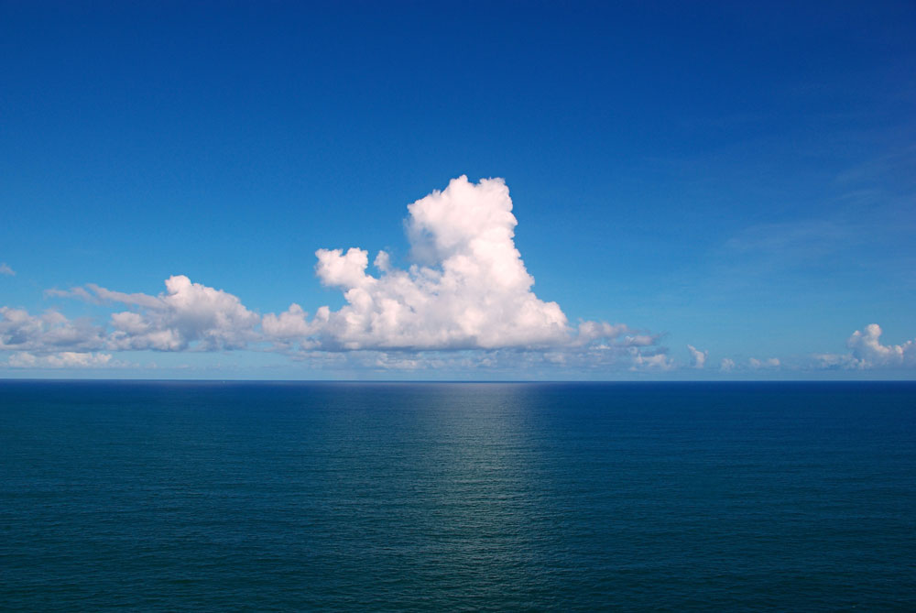
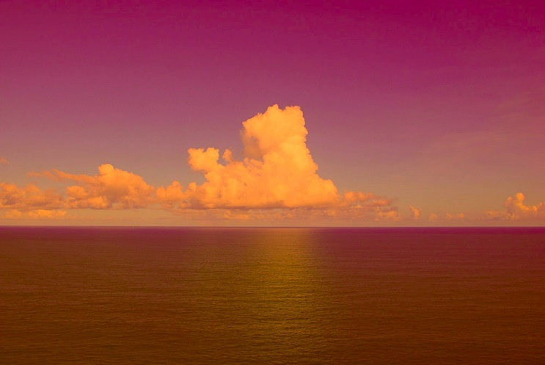
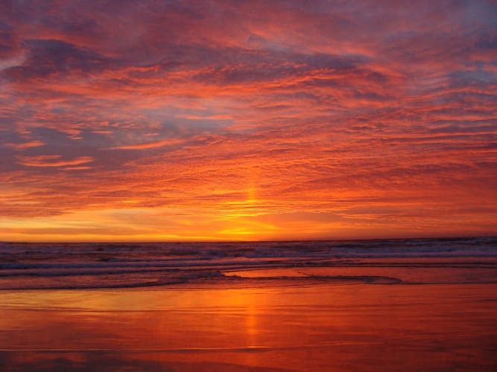
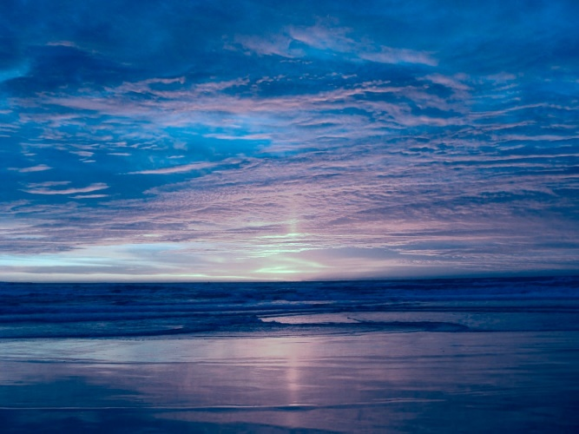
Level-1 RESULTS: Original images Matching variances
Notes:
This approach naturally extends to images with more than two clusters.

Slide 11
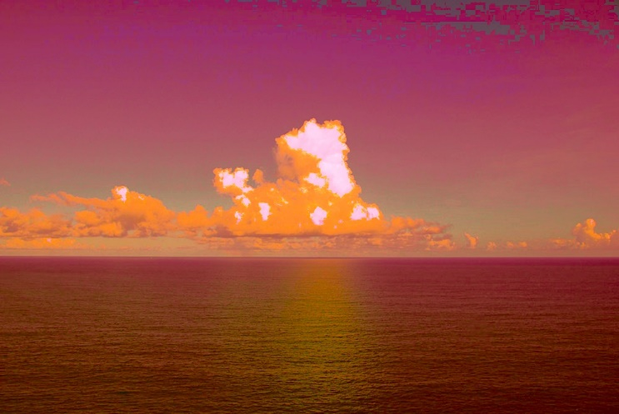
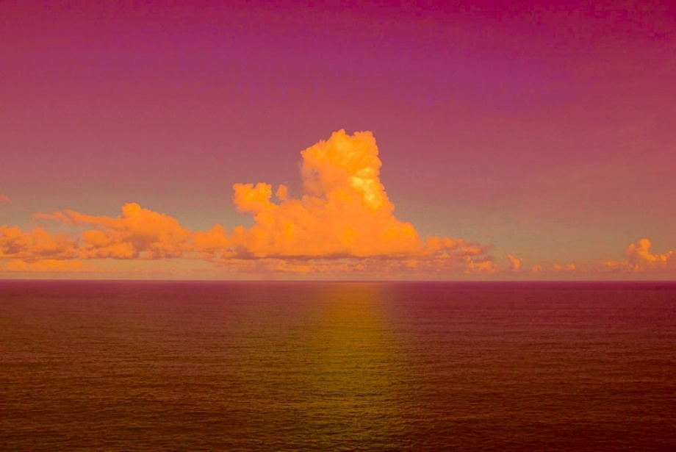
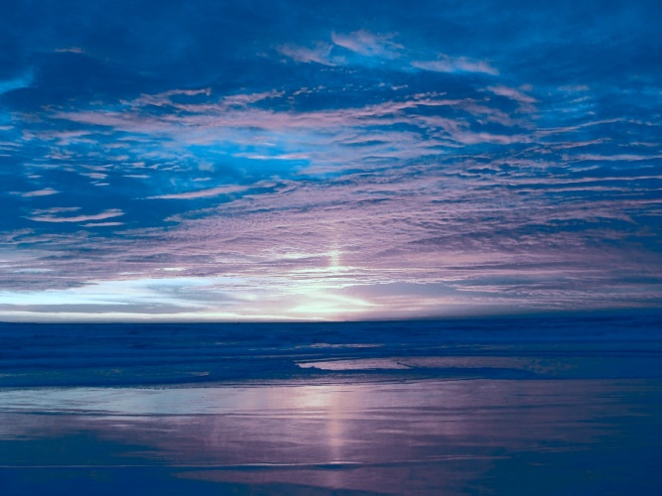
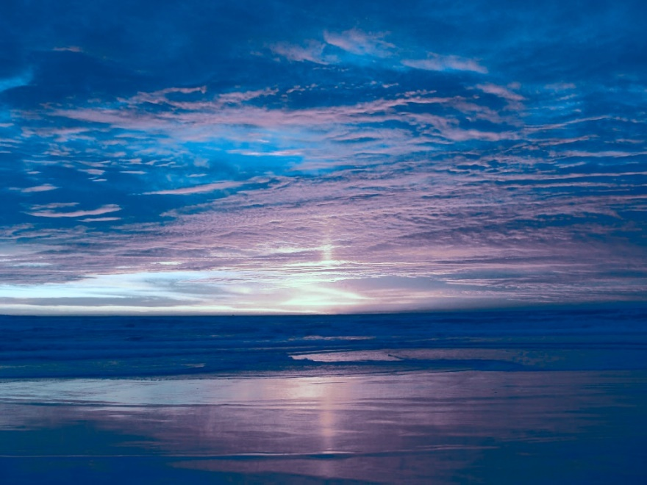
Level-2 RESULTS: matching distributions
swap ranked channel values Original images histogram matching
Notes:
This approach naturally extends to images with more than two clusters.

Slide 12
RESULTS
Level-2 swap ranked channel values Level-1 matching variances Level-2 histogram matching
Notes:
This approach naturally extends to images with more than two clusters.

Slide 13
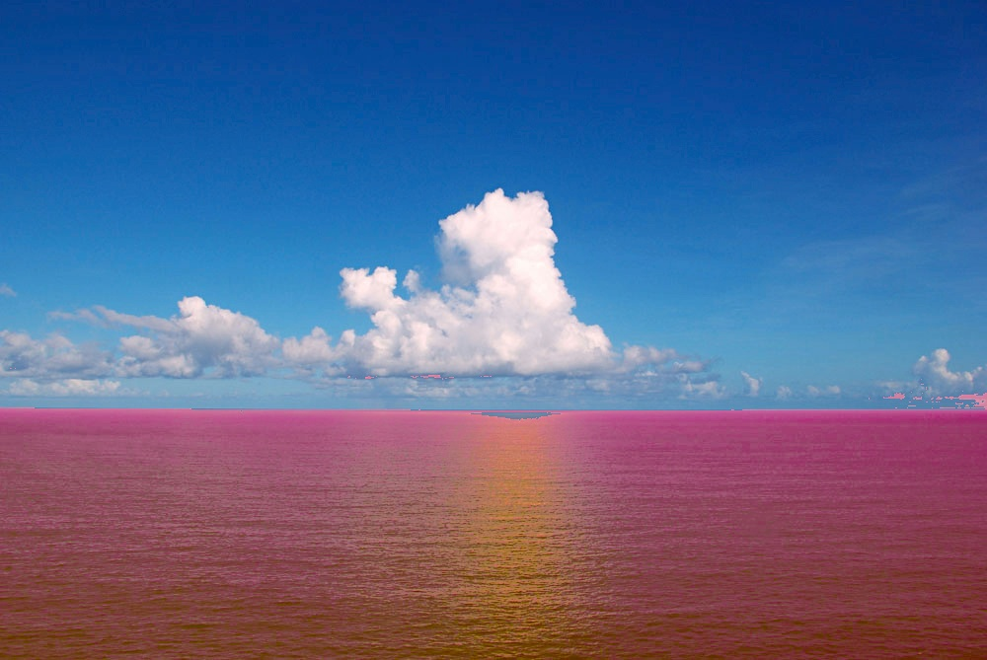
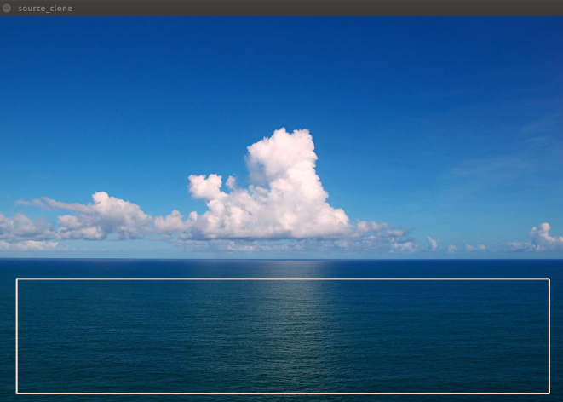
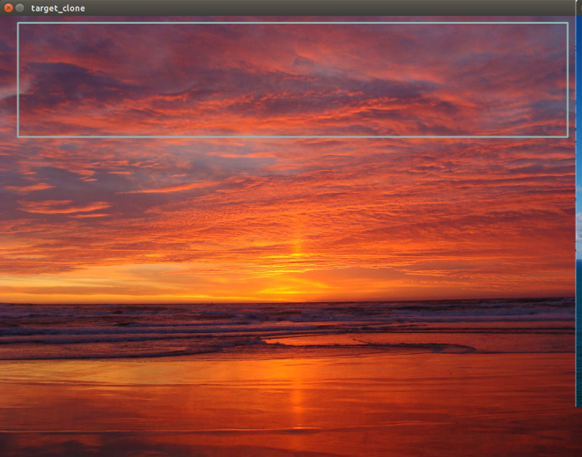
LEVEL-3: Partial Color Transfer
Image composition is an effective factor for higher success

Slide 14
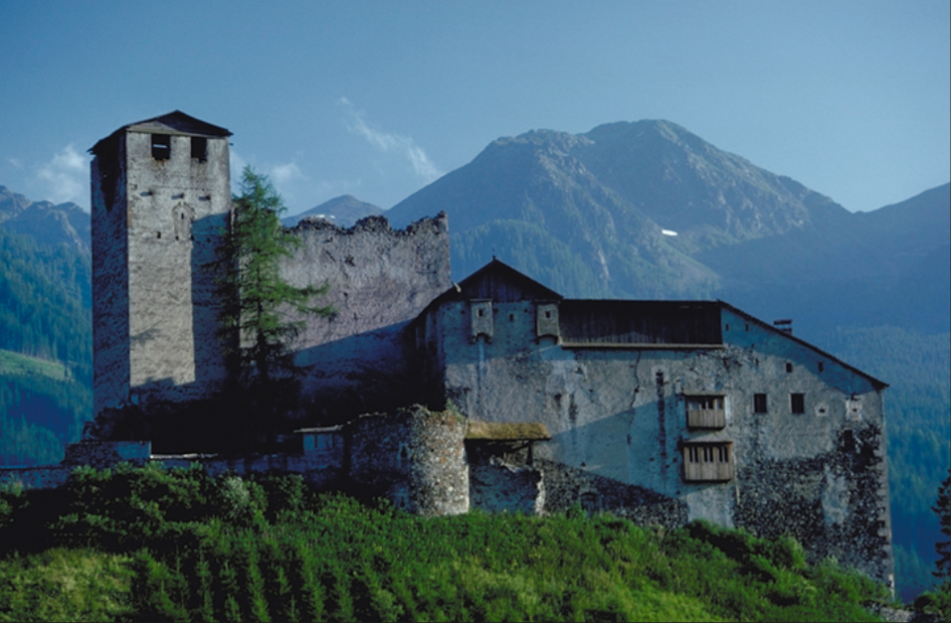
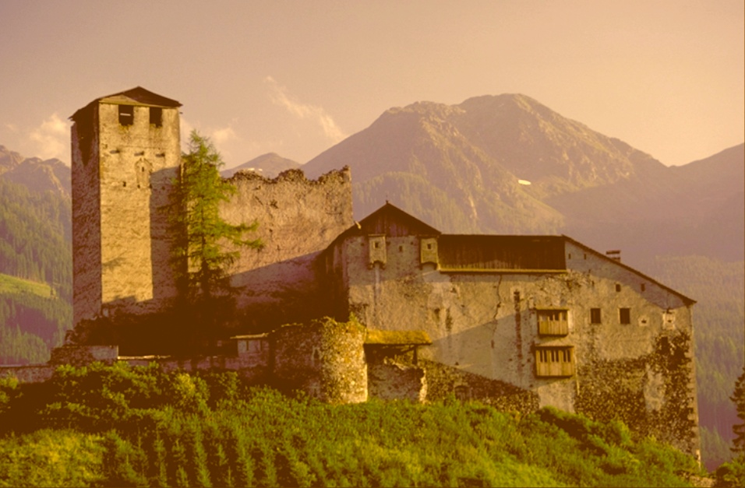
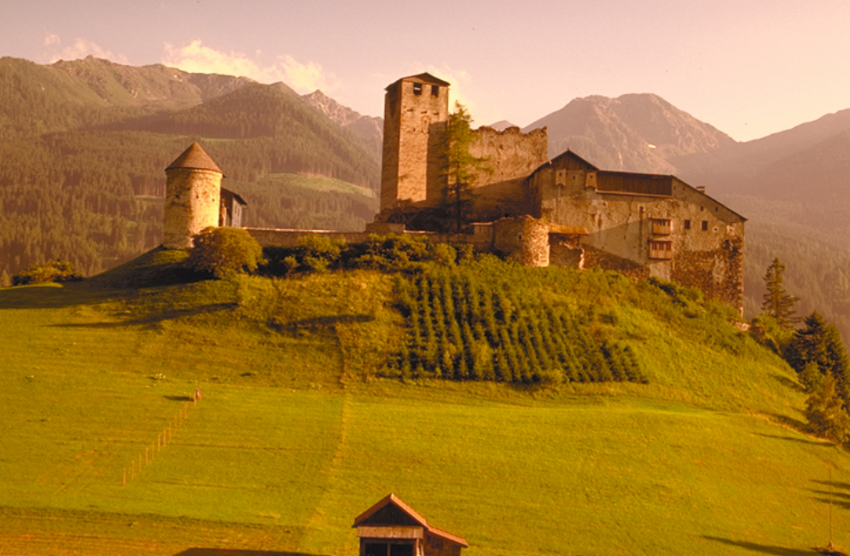
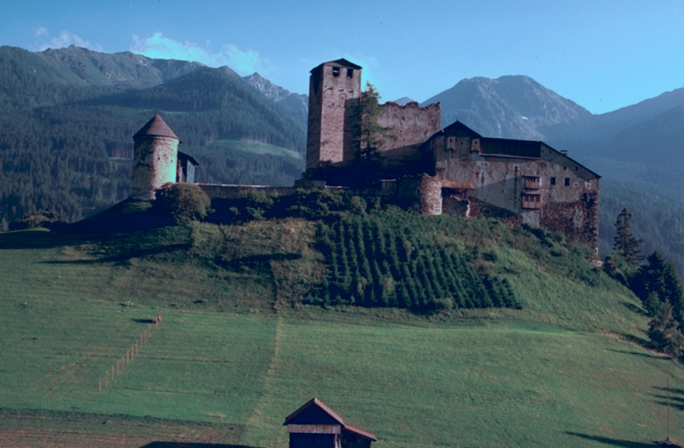
Level-1 RESULTS: Original images Matching variances
Notes:
This approach naturally extends to images with more than two clusters.

Slide 15
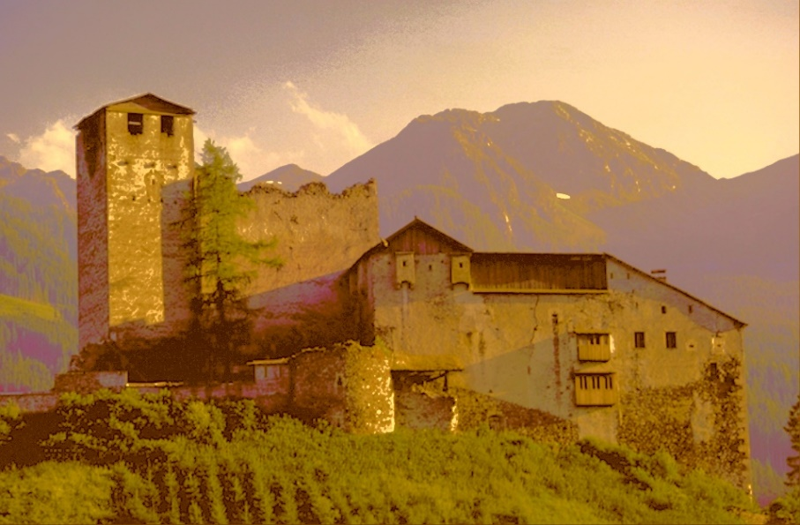
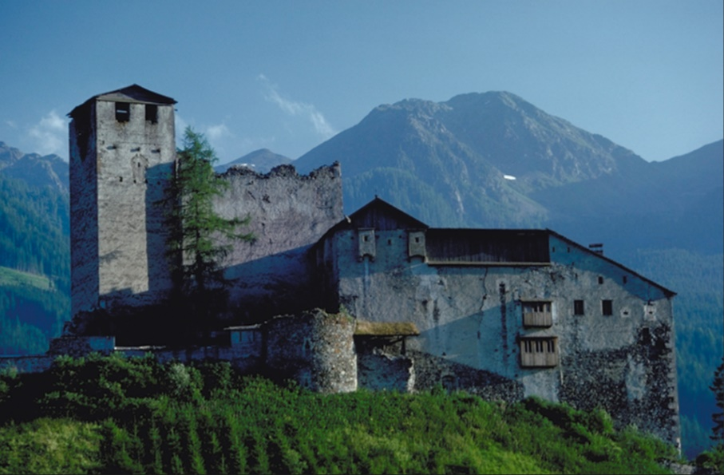
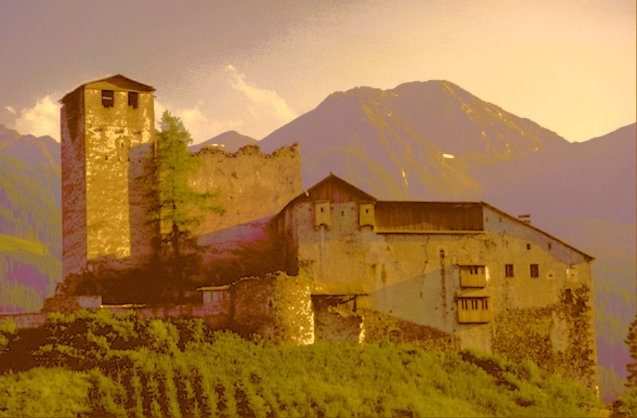
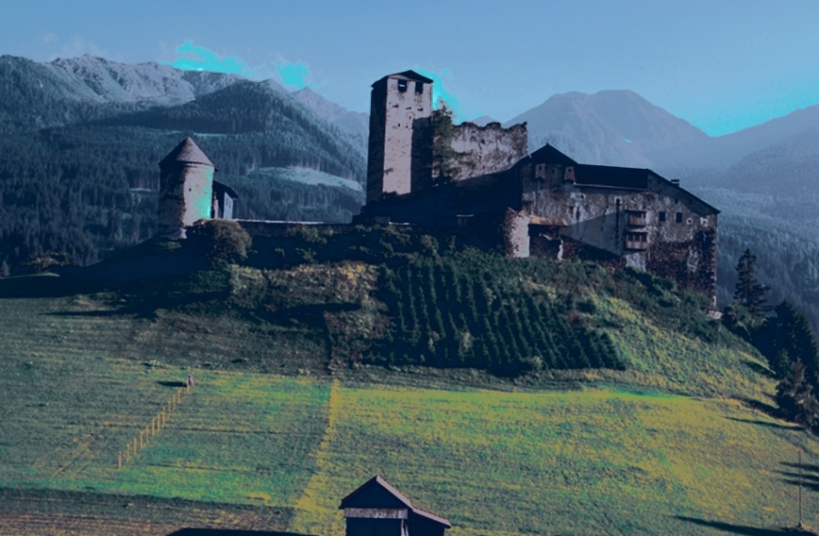

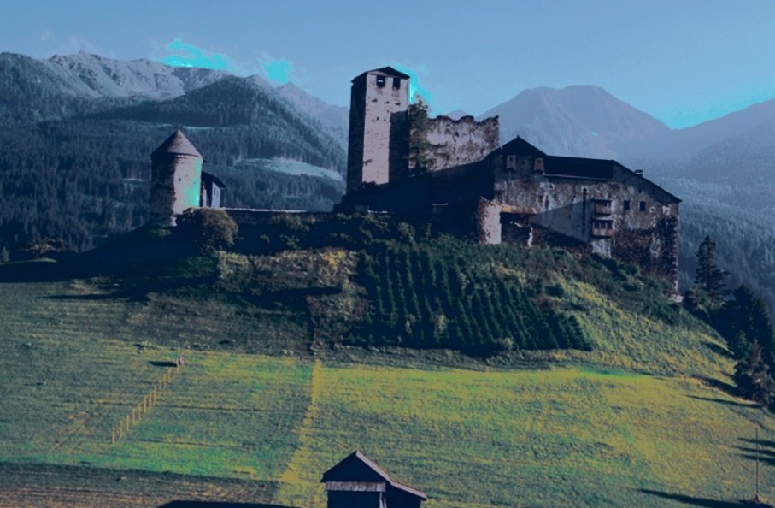
Level-2 RESULTS: matching distributions
swap ranked channel values Original images histogram matching
Notes:
This approach naturally extends to images with more than two clusters.

Slide 16

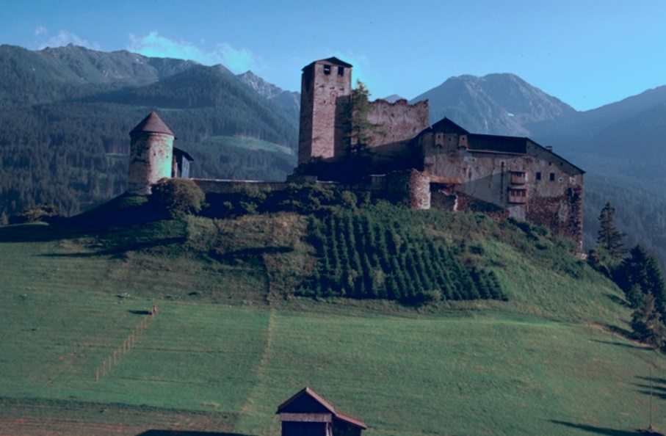
RESULTS
Level-2 swap ranked channel values Level-1 matching variances Level-2 histogram matching
Notes:
This approach naturally extends to images with more than two clusters.

Slide 17
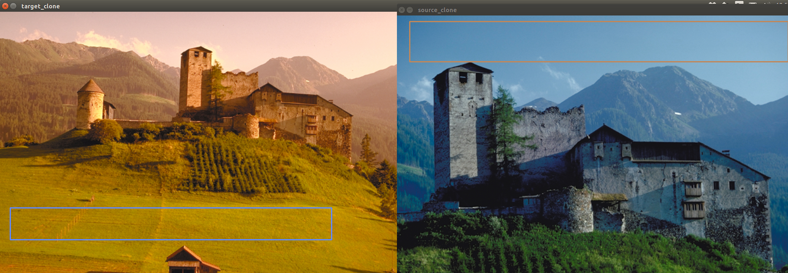
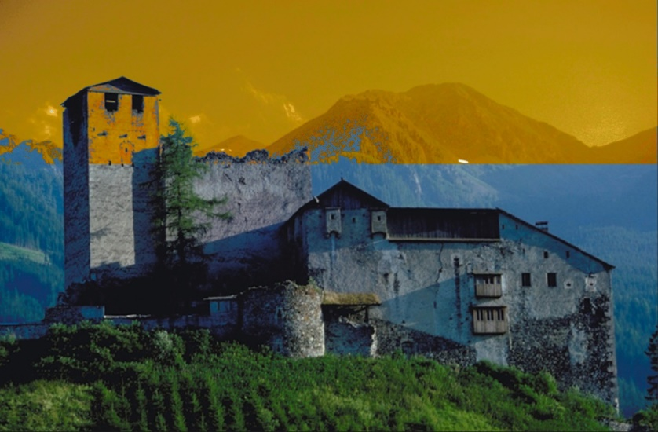
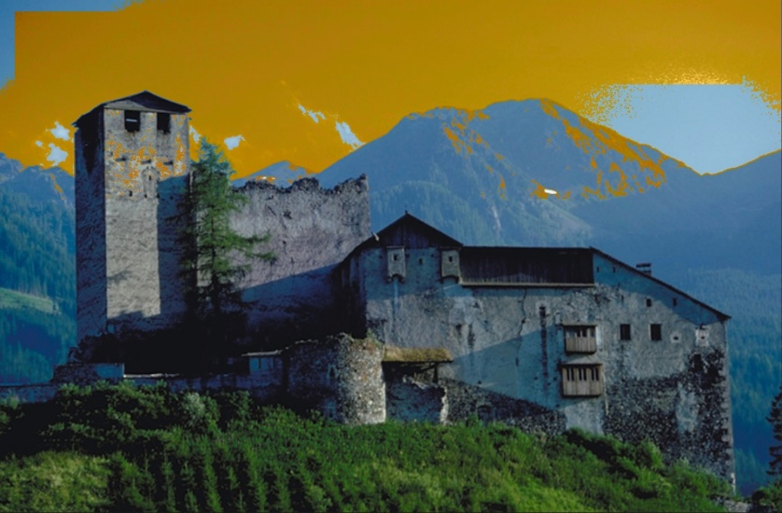
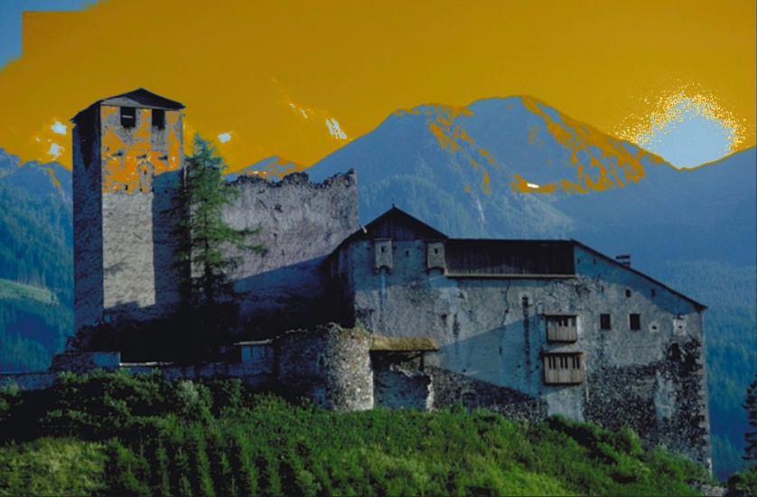
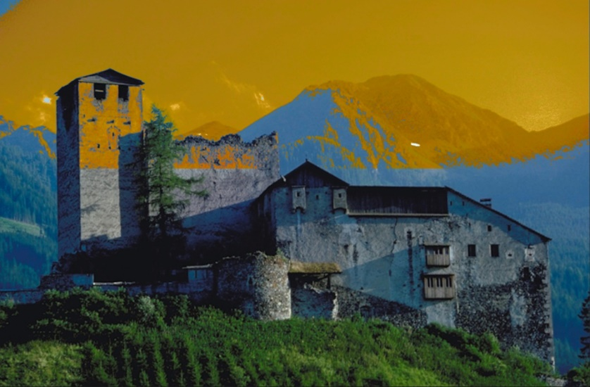
LEVEL-3: Partial Color Transfer Positional sensitivity and local calculations are necessary!
Trade of is too obvious

Slide 18
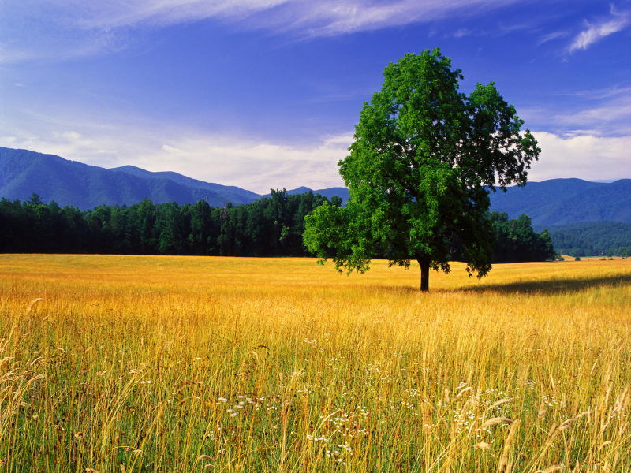
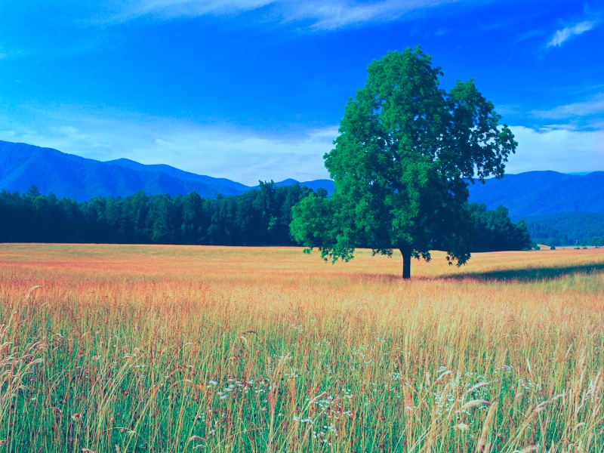
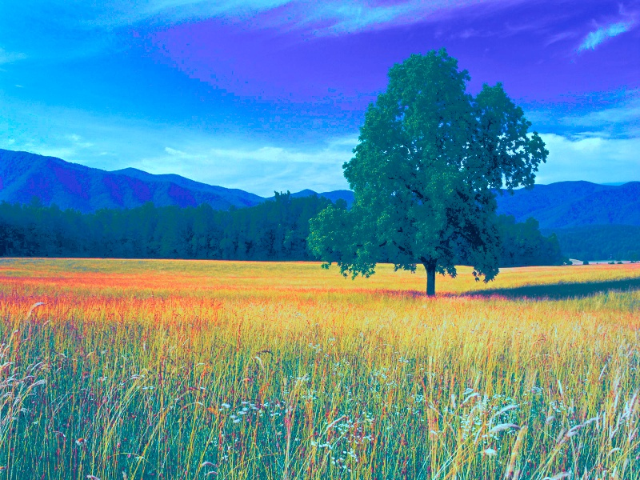
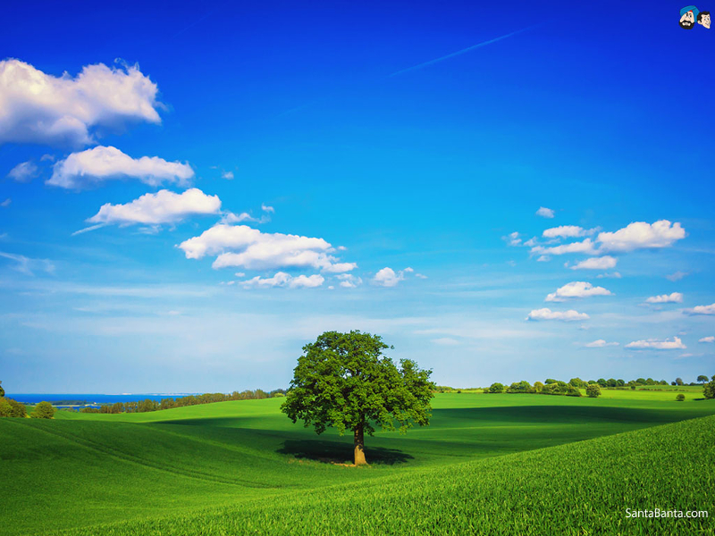
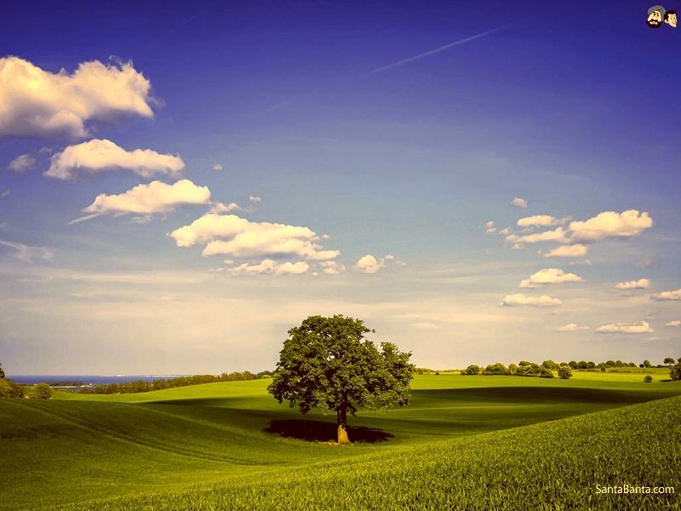
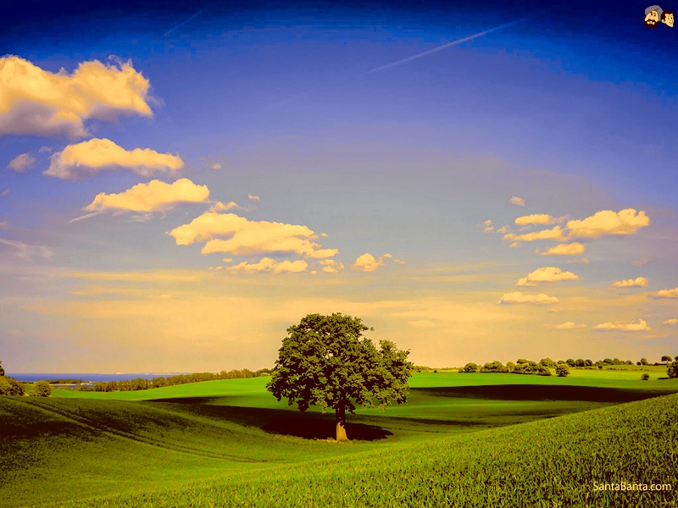
RESULTS
Original images Level-1 matching variances Level-2 histogram matching
Notes:
This approach naturally extends to images with more than two clusters.

Slide 19





LEVEL-3: Partial Color Transfer
Trade of is not obvious.
SAFE!

Slide 20



LEVEL-3: Partial Color Transfer
Concurrent transfer

Slide 21



LEVEL-3: Partial Color Transfer
Concurrent transfer

Slide 22


LEVEL-3: Partial Color Transfer
Sensitive to sharp color differences (high c1)

Slide 23

Level 3 – Another Approach
1- White balance and color space transformation.
White balancing.
Consistent color space: sRGB.
2- Color transfer using the selected components of two scenes.
Iterative non-linear minimization using angular error (Cheng et. al., 2015 ) between two colors.
, where a and b are source and target color vectors.
Our error function calculates Θ between source and target vector, at each iteration of quasi newton algorithm.
K-means clustering and watershed segmentation are applied on target image.
D. Cheng, B. Price, S. Cohen, and M. S. Brown. Effective learning-based illuminant estimation using simple features. In CVPR, 2015

Slide 24
Segmentation with K-Means Algorithm
Step 1: Convert image’s color space to LAB space.
L: Luminosity layer. A: Chromaticity layer where color falls along the red-green axis. B: Chromaticity layer where the color falls along the blue-yellow axis.
Step 2: We used A and B, since only A and B have color information. Then we also add 2D position information to our data to achieve better results. This way, K-Means finds partitions such that objects within each cluster are as close to each other as possible, and as far from objects in other clusters as possible.
Step3: Choose K parameter ,and run the algorithm 3 times.
Segmentation with K-Means Algorithm: http://www.mathworks.com/help/images/examples/color-based-segmentation-using-k-means-clustering.html?prodcode=IP&language=en , Accessed: 3.10.2015

Slide 25




Segmentation with Marker-Controlled Watershed Algorithm
Any greytone image can be considered as a topographic surface.
If we flood this surface from its minima and, if we prevent the merging of the waters coming from different sources, we partition the image into two different sets: the catchment basins and the watershed lines.
Marker-controlled watershed: http://cmm.ensmp.fr/~beucher/wtshed.html, Accessed: 10.10.2015

Slide 26



Segmentation with Marker-Controlled Watershed Algorithm
Watershed algorithm can cause over segmentation problem, since natural images have noise and local irregularities. Solution is: Marker controlled watershed algorithm.
Marker-controlled watershed: http://cmm.ensmp.fr/~beucher/wtshed.html, Accessed: 10.10.2015

Slide 27
Reference image:

Slide 28


GUI for selection of color patches.
We calculate average of each patch to find color vector.
We can add more than one reference and target color.

Slide 29



Sample 1
Reference: Orange patch in color chart.
Target: Red of pillow in scene.
Notes:
MOST LEFT ORIGINAL, LEFT OPTIMIZATION, most right clustering result, kmeans k=5

Slide 30

Sample 2
Reference: Red patch in color chart.
Target: Green face toy in scene.
Notes:
MOST LEFT ORIGINAL, LEFT OPTIMIZATION, most right clustering result, kmeans k=5

Slide 31

Sample 3
Reference: Blue patch in color chart.
Target: Red of pillow is in scene.
Notes:
MOST LEFT ORIGINAL, most right clustering result, LEFT OPTIMIZATION, kmeans k=5

Slide 32


Sample 4
Reference: Orange patch in color chart.
Target: Green face toy in scene.
Notes:
MOST LEFT ORIGINAL, LEFT OPTIMIZATION, most right clustering result, kmeans k=2 i

Slide 33


Sample 5
Reference: Orange patch in color chart.
Target: Green face toy in scene.
Reference: Pink patch in color chart.
Target: Red of pillow in scene.
Notes:
MOST LEFT ORIGINAL, LEFT OPTIMIZATION, most right clustering result, kmeans k=3

Slide 34

Sample 6
Reference: Orange patch in color chart.
Target: Green face toy in scene.
Reference: Purple patch in color chart.
Target: Red of pillow in scene.
Notes:
MOST LEFT ORIGINAL, LEFT OPTIMIZATION, most right clustering result, kmeans k=3

Slide 35




Sample 7
Reference: Pink patch in color chart.
Target: Red of pillow in scene.
Notes:
MOST LEFT ORIGINAL, LEFT OPTIMIZATION, most right clustering result, with watershed algorithm

Slide 36

Sample 8
Reference: Purple patch in color chart.
Target: Red of pillow in scene.
Notes:
MOST LEFT ORIGINAL, LEFT OPTIMIZATION, most right clustering result, with watershed algorithm

Slide 37



Sample 9
Reference: Blue patch in color chart.
Target: Red of pillow in scene.
Reference: Orange patch in color chart.
Target: Green face toy in scene.
Notes:
MOST LEFT ORIGINAL, LEFT OPTIMIZATION, most right clustering result, with watershed algorithm

Slide 38
Thank you.

